Slide 1

DEPARTMENT OF COMPUTER SCIENCE AND ENGINEERING
Title: Real-Time Cyberbullying Detection on User Generated Content using NLP Techniques and SVM
BATCH ID : 23MPCS-H6
S. No | Roll. No | Student Name
1 | 23881A05GP | P Rishita
2 | 23881A05ET | A Abhinay
3 | 23881A05FN | J Ashvith Reddy
4 | 22881A0552 | S Shirisha
Guide Details
Mr. Rajkumar B Patil
Associate Professor
Department of CSE

Slide 2
Mini Project Outlines
Introduction
Existing System Vs Proposed
Research Gaps
Problem Statement
Proposed Project Objectives
Proposed Project Outcomes
Software and Hardware Requirements
Architectural Diagram
Proposed Methods and Algorithms
Results
Research Paper (Acceptance Proofs)
Conclusion

Slide 3
Introduction
Social media platforms generate massive user content daily.
Cyberbullying is a serious issue affecting mental health, especially among teenagers.
Traditional moderation methods are often manual or keyword-based, leading to low accuracy.
Real-time detection can help prevent harassment and promote safer online interactions.
Our project focuses on detecting cyberbullying using NLP techniques and Support Vector Machine (SVM) models.

Slide 4
Existing System Vs Proposed
Aspect | Existing System | Proposed System
Detection Method | Manual moderation, keyword-based | Automated, NLP + SVM
Accuracy | Moderate, prone to false positives/negatives | Higher, context-aware classification
Scalability | Limited to small datasets | Scalable to large social media datasets
Feature Extraction | Simple word matching | TF-IDF, Bag-of-Words, tokenization, lemmatization
Real-Time Detection | Limited or offline | Real-time detection of user content
User Safety | Reactive approach | Proactive prevention of cyberbullying
DEPARTMENT OF CSE : MINI PROJECT

Slide 5
Research Gaps
Limited Context Awareness –Many existing cyberbullying detection systems rely solely on keyword matching, missing nuanced language, sarcasm, slang, and abbreviations.
Poor Cross-Platform Generalization – Models trained on one platform may not perform well on others due to differences in user behavior and language.
Small or Imbalanced Datasets – Many studies use datasets that are either too small or skewed, reducing the accuracy and reliability of models.
Insufficient Evaluation Metrics – Some studies only report accuracy, ignoring precision, recall, and F1-score, which are critical for imbalanced datasets.
Reliance on Static Keyword Lists – Most existing systems cannot detect context-based bullying or evolving slang.
DEPARTMENT OF CSE : MINI PROJECT

Slide 6
Problem Statement
Cyberbullying is a growing issue on social media that negatively impacts mental health and online safety. Existing detection systems are largely manual or rely on simple keyword matching, which leads to low accuracy, delayed responses, and an inability to understand context, slang, sarcasm, or emotions. There is a critical need for a real-time, automated solution that can efficiently analyze user-generated content, accurately identify cyberbullying, and provide explainable results. This project aims to address this challenge by using Natural Language Processing (NLP) techniques and Support Vector Machine (SVM) models to detect harmful content instantly and reliably.
DEPARTMENT OF CSE : MINI PROJECT

Slide 7
Proposed Project Objectives
Implement NLP preprocessing to clean and normalize user-generated text.
Extract features using TF-IDF, Bag-of-Words, and sentiment analysis.
Train a Support Vector Machine (SVM) classifier to detect cyberbullying.
Enable real-time detection of harmful content on social media platforms.
Provide explainable outputs to clarify why content is flagged.
Deploy a user-friendly web application to handle live and batch data.
DEPARTMENT OF CSE : MINI PROJECT

Slide 8
Proposed Project Outcomes
Real-Time Cyberbullying Detection: The system can instantly identify and flag harmful or offensive content on social media platforms.
Improved Accuracy: NLP and SVM-based approach ensures higher accuracy compared to keyword-based systems, capturing context, slang, and sarcasm.
Explainable Results: Provides understandable explanations for why content was flagged, helping moderators make informed decisions.
Scalability: Capable of handling large volumes of social media data efficiently.
User-Friendly Web Application: A functional interface for live input or batch processing, making the system accessible to non-technical users.
DEPARTMENT OF CSE : MINI PROJECT

Slide 9
Software and Hardware Requirements
Software | Hardware
Programming Language: Python | Processor: Intel i5 or higher
Development Environment: Jupyter Notebook or VS Code | RAM: 8 GB or higher
Streamlit/Flask for UI | Storage: 100 GB
Libraries: scikit-learn, nltk, pandas, numpy, matplotlib, seaborn | GPU (optional for faster feature extraction and training)
DEPARTMENT OF CSE : MINI PROJECT

Slide 10
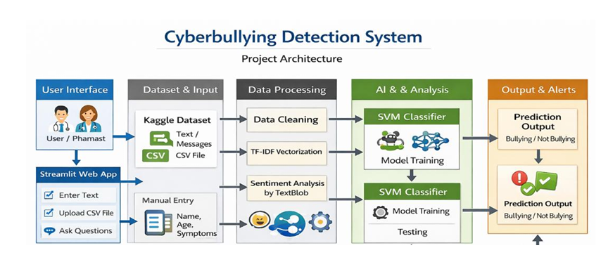
Architectural Diagram
DEPARTMENT OF CSE : MINI PROJECT

Slide 11
PROPOSED METHOD AND ALGORITHMS
Proposed Method:
Text Preprocessing – Raw text is cleaned by converting to lowercase, removing punctuation, URLs, stopwords, and applying tokenization and lemmatization
Feature Extraction – Text is transformed into numerical features using TF-IDF, Bag-of-Words, and additional context features like sentiment, sarcasm indicators, and personal attack markers.
Machine Learning Prediction – A Support Vector Machine (SVM) classifier analyzes the features to predict whether a message is cyberbullying or harmless.
Output and Alerts – The system flags harmful content, generates explainable results showing why it was classified as bullying, and displays the output in a web application interface.
DEPARTMENT OF CSE : MINI PROJECT
DEPARTMENT OF CSE : MINI PROJECT

Slide 12
PROPOSED METHOD AND ALGORITHMS
Algorithms Used:
Support Vector Machine (SVM) – Supervised machine learning algorithm that classifies content into cyberbullying or non-cyberbullying based on extracted features.
Natural Language Processing (NLP) Techniques – Includes tokenization, lemmatization, stopword removal, and TF-IDF for converting text into analyzable numerical data.
Sentiment and Emotion Analysis – Detects emotional cues in text that may indicate harmful intent.
Streamlit Interface – For deploying a user-friendly web app that handles real-time and batch content analysis.
DEPARTMENT OF CSE : MINI PROJECT
DEPARTMENT OF CSE : MINI PROJECT

Slide 13
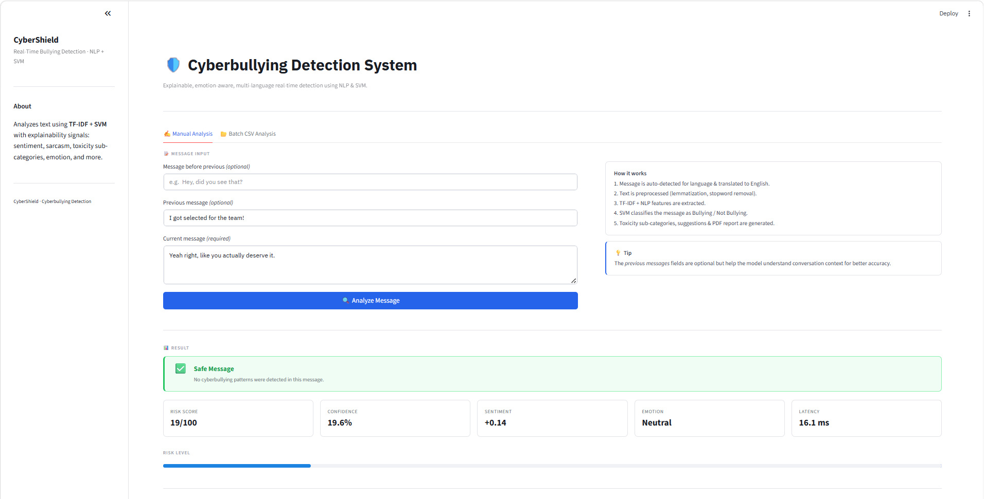
Results
DEPARTMENT OF CSE : MINI PROJECT

Slide 14
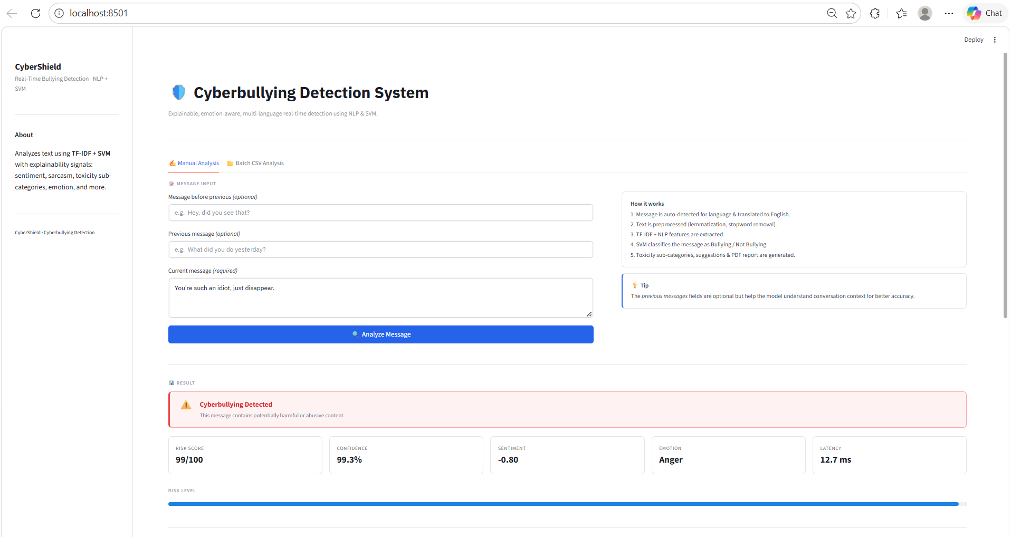
Results
DEPARTMENT OF CSE : MINI PROJECT

Slide 15
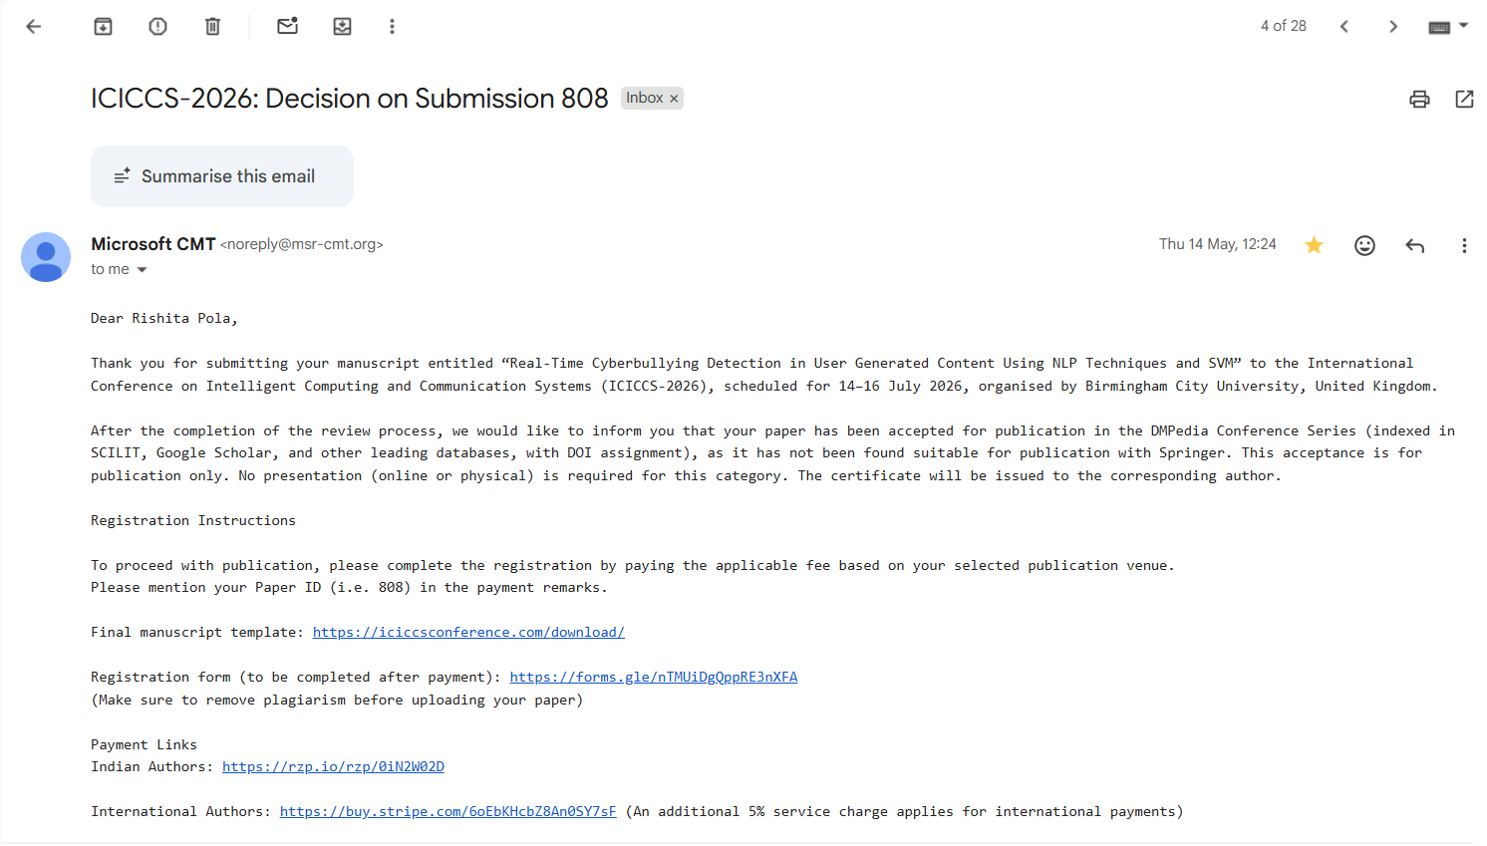
Research Paper (Acceptance Proof)
DEPARTMENT OF CSE : MINI PROJECT
DEPARTMENT OF CSE : MINI PROJECT

Slide 16
Conclusion
The project successfully implements a real-time cyberbullying detection system using NLP techniques and SVM, capable of analyzing user-generated content on social media. By combining text preprocessing, feature extraction, sentiment and emotion analysis, and a supervised machine learning model, the system can accurately detect harmful posts while providing explainable results. Deployed as a user-friendly web application, it supports both live and batch processing, offering a practical solution for moderating online communities. Overall, the framework enhances online safety, promotes responsible social media use, and provides a scalable approach for future cyberbullying detection efforts.
DEPARTMENT OF CSE : MINI PROJECT

Slide 17
Thank You
DEPARTMENT OF CSE : MINI PROJECT

